Slide 1

What makes the best tennis player?
HAMOYE-CATBOOST

Slide 2
CATBOOST FAMILY
Team Members
Shedrack David
Ayoola Damilare
Othniel Mejabi
Oreoluwa Sobiye
​Mukhtar Abdulquadir
​Chinelo Okeke
​Ramahadi Moheane
Jeff Bassey Okoi
Philip Obekpa
PRESENTERS
Othniel Mejabi
Monica Nahabwe
REPRESENTATIVES
Project Lead: Tshifhumulo Mapasa
Assistant Project Lead: Bolutito Ayodeji
Query Analyst: Monica Nahabwe

Slide 3
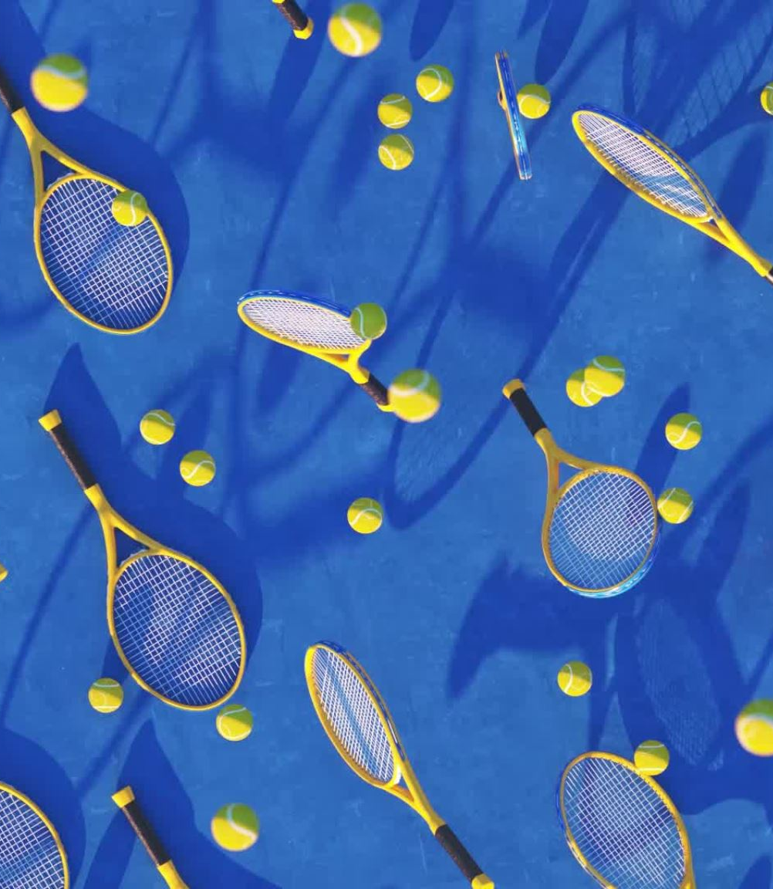
PRESENTATION OUTLINE
Problem Statement
Objectives and Audience
Our Approach
Dataset Description
Results
Conclusion

Slide 4
PROBLEM STATEMENT
Tennis has become very popular and is supported worldwide. Moreover, it is an officially recognized Olympic sport.
However, there is little information about the characteristics and performance indicators of top players. The performance indicators can be used by players, coaches and sport scientists to better prepare players and improve performance.
Our project will address this gap by analyzing the Association of Tennis Professional matches dataset from 2000 to 2017.

Slide 5
OBJECTIVES AND AUDIENCE
Objectives
To identify the top tennis players.
To establish the demographic characteristics of the top tennis layers.
To establish the key performance indicator of top best players.
Target audience
Tennis managers/agencies.
Underperforming and aspiring tennis players.

Slide 6
OUR APPROACH
Data Wrangling and Preparation:
Merged tables and dropped features.
Removed duplicates and missing values.
Formatted the datasets.
Data Analysis:
Statistical Analysis : Employed descriptive statistics to compare top ten winners.
Findings and Discussions
Visualized findings by graphs and charts.
Conclusion drawn from the trends.

Slide 7
DATASET DESCRIPTION
ORIGIN: Our dataset was downloaded from Kaggle (https://www.kaggle.com/datasets/gmadevs/atp-matches-dataset). It contains eighteen tables about the association of tennis professional matches from 2000 to 2017. Each table consist of 49 columns, with features about the tournaments, winners and losers.

Slide 8
RESULTS
HAMOYE-CATBOOST

Slide 9
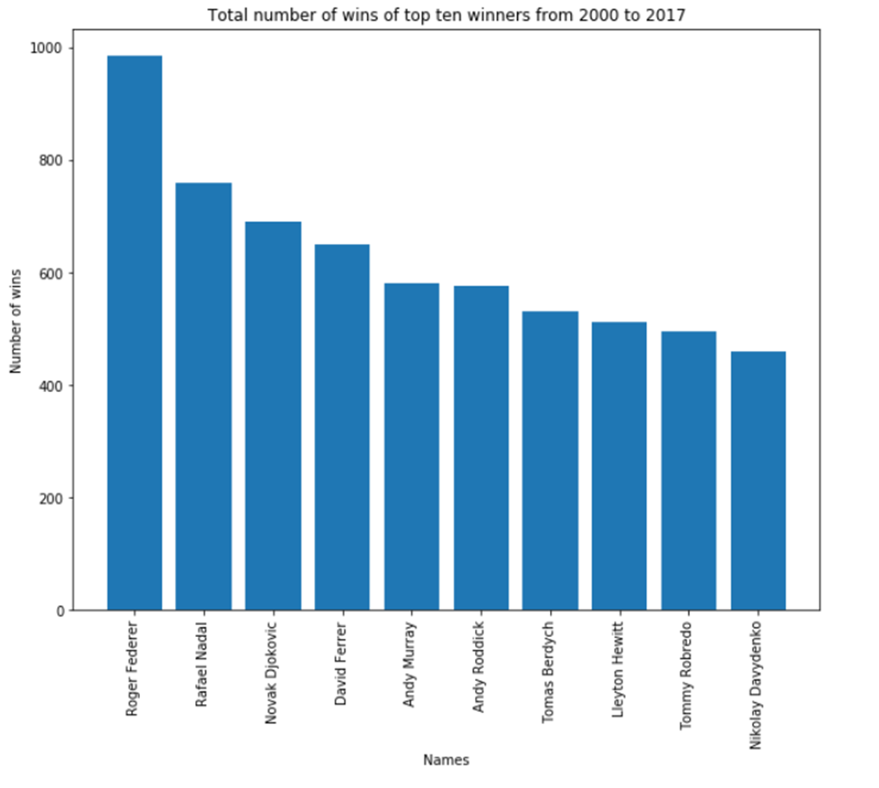
TOP 10 WINNERS WITH MOST WINS
Roger Federer
Rafael Nadal
Novak Djokovic
David Ferrer
Andy Roddick
Lleyton Hewitt
Andy Murray
Tommy Robredo
Tomas Berdych
Nikolay Davydenko

Slide 10
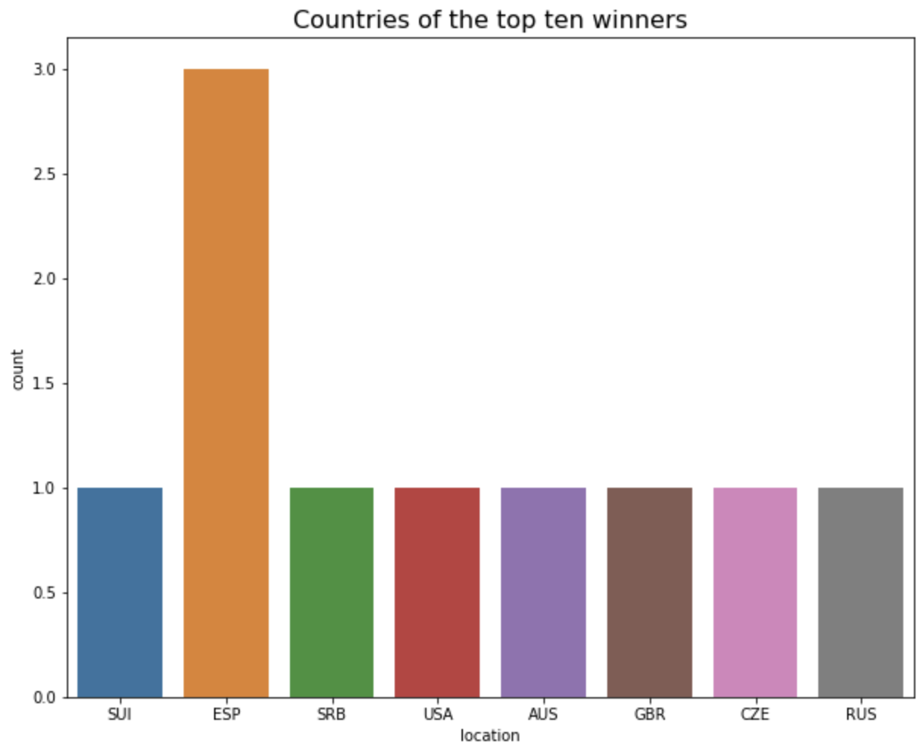
LOCATION
Switzerland, Serbia, United State of America, United Kingdom, Czech Republic, Chile and Australia have one top tennis player. However, Spain has three top players.

Slide 11
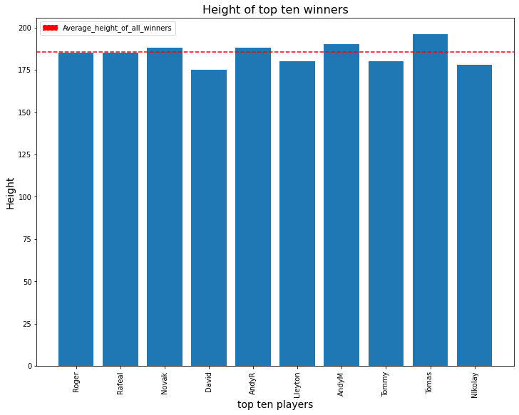
HEIGHT
40% of top winners have height above the average height of players and 60% of top winners have height below the average height.

Slide 12
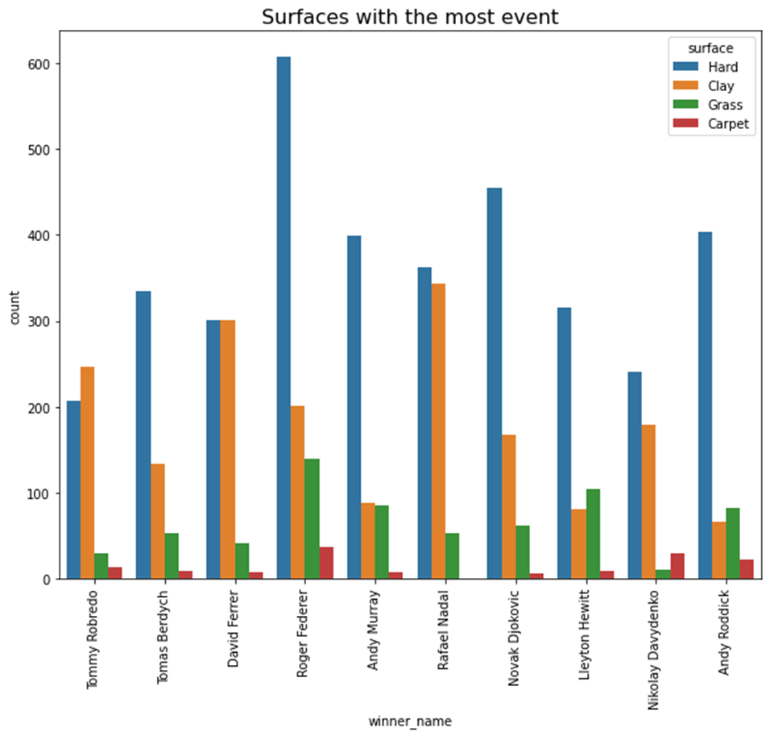
SURFACES
Most players played most of their match on the Hard surface, followed by Clay surface.

Slide 13
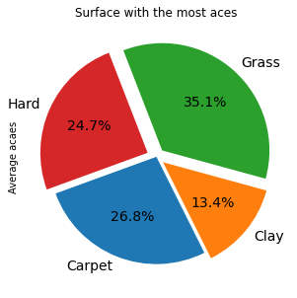
SURFACES
However, more aces were accumulated on the Grass surface and least on the Clay surface.

Slide 14
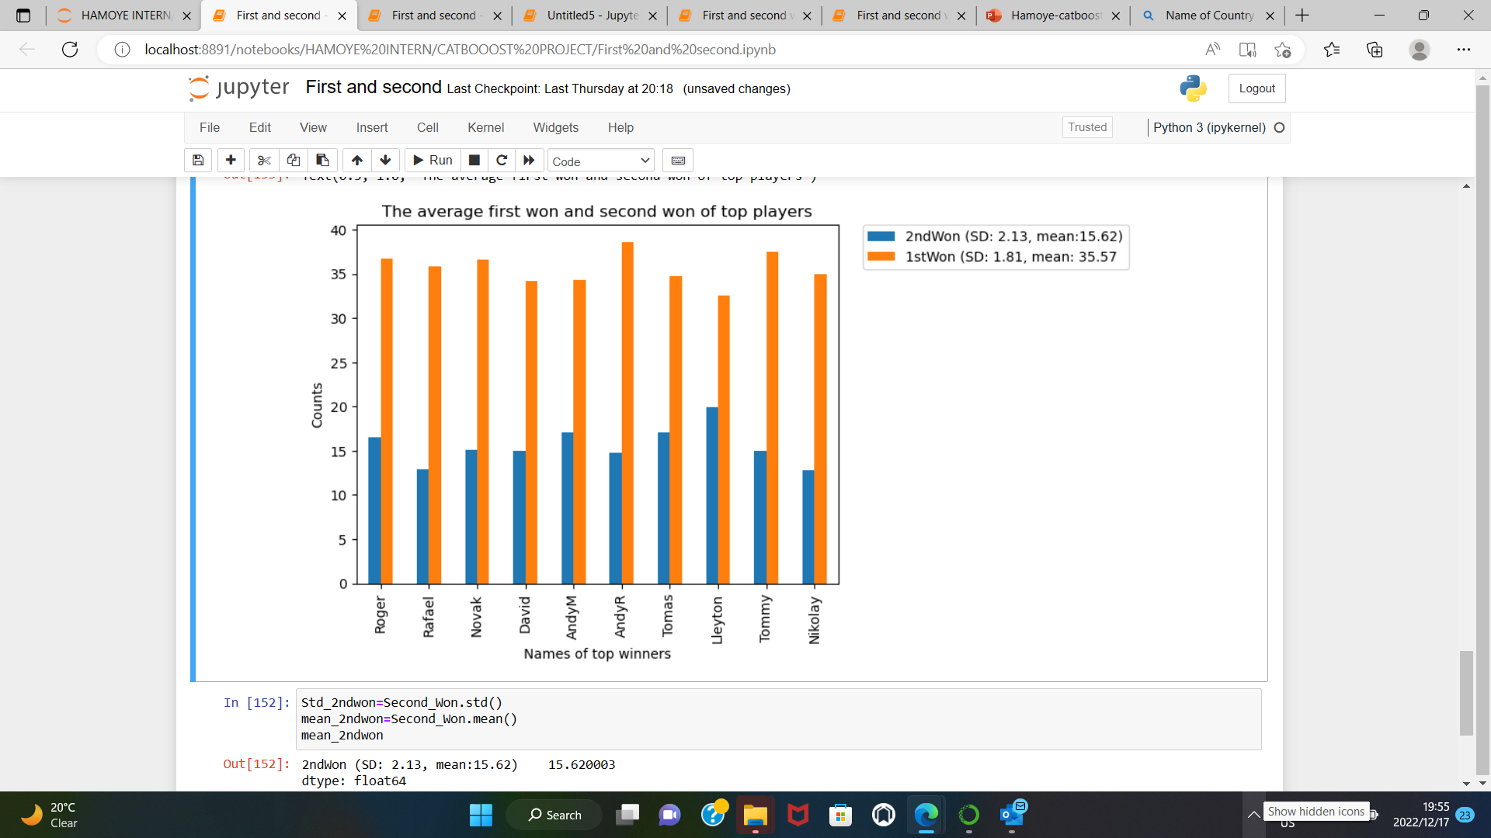
FIRST AND SECOND SERVE WINS
The average first and second serve wins
Top winners win an average of 35.6 first serve and 15.62 second serve. Which means top winners win first serve two times more than the second serve.

Slide 15
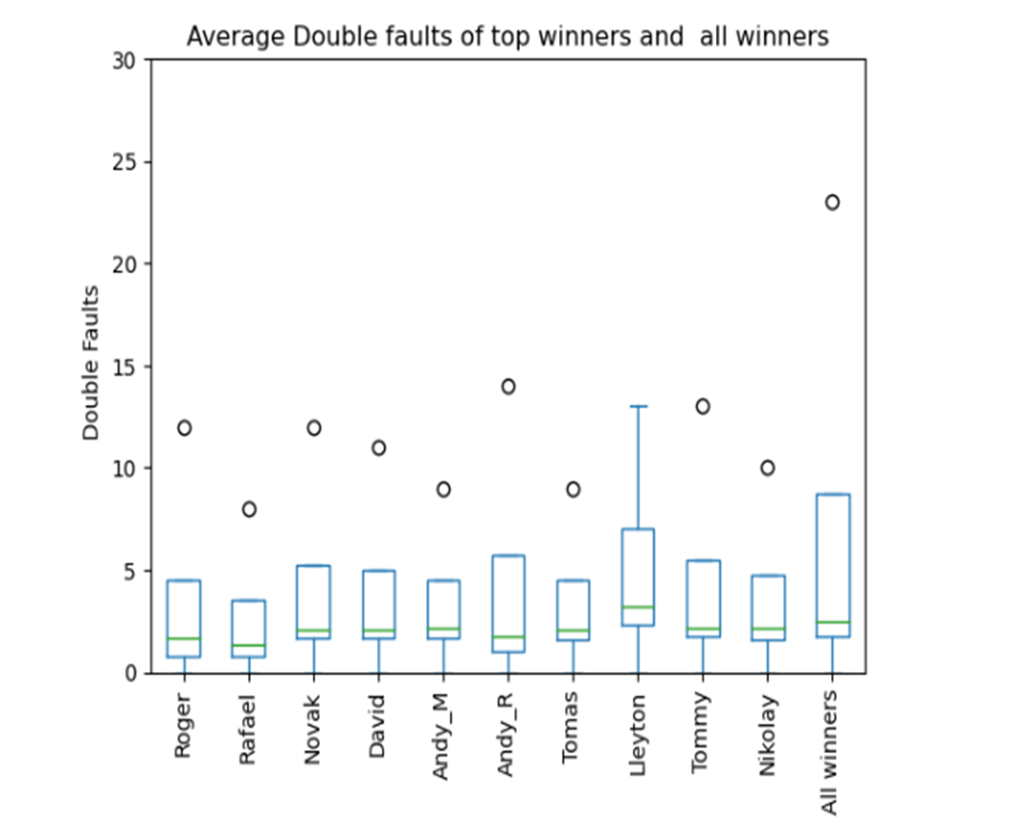
DOUBLE FAULTS
Most top winners face low double faults than the an average winner. However, this is with exception of Lleyton.

Slide 16
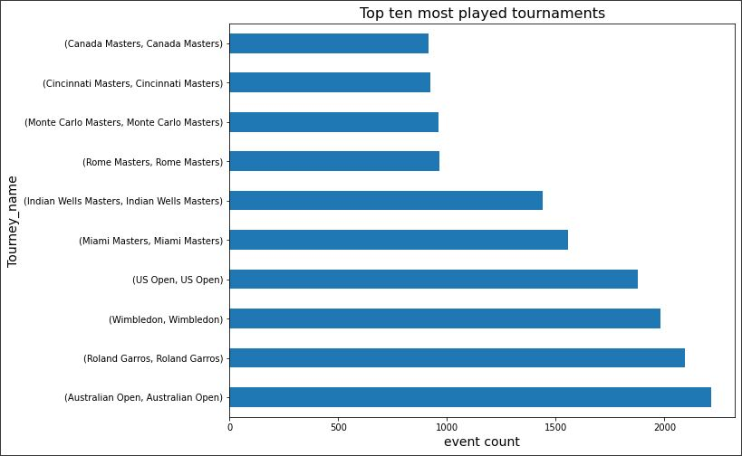
TOP TEN MOST PLAYED TOURNAMENTS
Ten of the most played tournaments from the year 2000 to 2017 have over 1000 events.

Slide 17
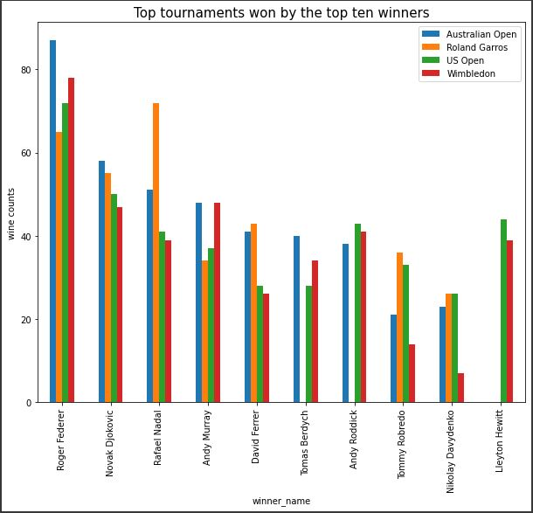
TOP TOURNAMENTS WINS OF TOP 10 WINNERS
Most of the top ten winners dominated at least 3 of the top 4 tournaments.
The top 3 winners won all four tournaments.

Slide 18
CONCLUSION
1. Best players maximize their aces on the Grass surface.
2. Clay is the natural surface of Spain and this surface is very vital for the development of a player. Thus, to become the top player, it is vital to practice on Clay surface.
3. Top players take advantage of their first serve. However, if they fail during their first serve, they still have potential of winning their second serve.
4. Top player are coached in the direction of reducing the number of double faults.
5. The height of player has a minimal bearing on the performance of the top players.
6. To be considered as a top or outstanding tennis player, it is crucial to really dominate at least 2 or 3 of the top ten tennis tournaments
​

Slide 19
THANK YOU FOR HAVING US.
CATBOOST FAMILY

